Slide 1



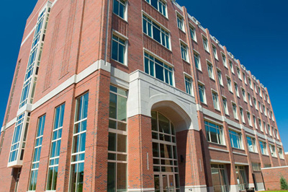
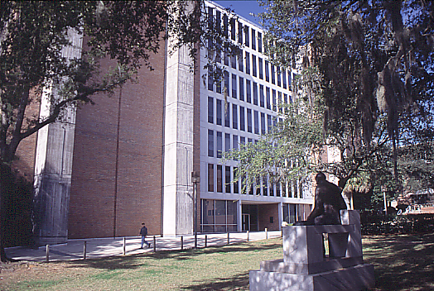
NSF-REU: Sunshine Institute for the
Interaction of Light with Matter
(updated June 11, 2025 at 2:30 p.m.)
Ed Hilinski and Bridget DePrince
https://www.chem.fsu.edu/reu/
Department of Chemistry and Biochemistry
Florida State University
Tallahassee, Florida 32306-4390
Acknowledgment: We thank the NSF-Research Experiences for Undergraduates (REU) Sites program.
This material is based upon work supported by the NSF under Grant CHE-2150301.
1

Slide 2
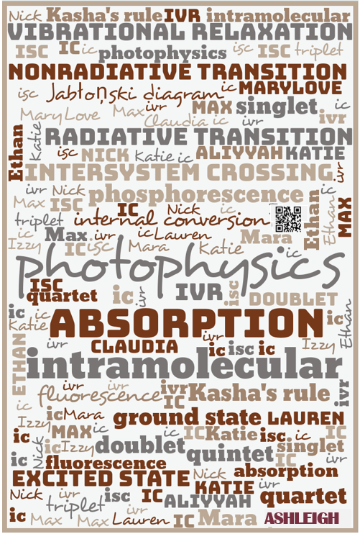
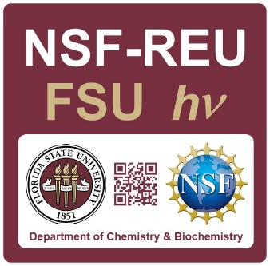
NSF-REU: Sunshine Institute for the
Interaction of Light with Matter
Summer 2025 - May 27 to Aug 1
Ed Hilinski and Bridget DePrince
https://www.chem.fsu.edu/reu/
Department of Chemistry and Biochemistry
Florida State University
Tallahassee, Florida 32306-4390
Acknowledgment: We thank the NSF-Research Experiences for Undergraduates (REU) Sites program.
This material is based upon work supported by the NSF under Grant CHE-2150301.
2

Slide 3

NSF-REU: Sunshine Institute for the Interaction of Light with Matter
Department of Chemistry and Biochemistry, Florida State University
A Chronology
First Day - May 27, 2025 – Welcome!
REU Particpant Home Institution In-Lab Mentor Faculty Advisor
Mara Connelly
Katie Crouch
Ethan Dailey
MaryLove Han
Maxwell Kovall
Lauren Noggle
Nicholas Paris
Aliyyah Roberson
Ashleigh Roberts
Isabella Thompson
Claudia Woody
Shippensburg University
University of Houston
Univ. Tennessee at Chattanooga
Berry College
Miami University (Ohio)
University of West Florida
California State Univ., San Marcos
Univ. Maryland, Baltimore County
New College of Florida
Kenyon College
Florida State University
Lei Zhu
Eugene DePrince
Geoffrey Strouse
Susan Latturner
Jack Saltiel
& Ed Hilinski
Biwu Ma
Bryan Kudisch
Kenneth Hanson
Michael Shatruk
Igor Alabugin
Jack Salltiel
& Ed Hilinski
Lucy Jenkins
Stephen Yuwono
Sarah D. Bennett
Justin Oh
& Femi Araoyinbo
Sulthana Fehroza P P
& Sumesh Babu Krishnan
Mohammad Khizr
& Sahel Moslemi
Thomas Brumback
& Rachel Clark
Ethan Lambert
& Holly Konrad
Shubham Bisht
& Divya Kumar
Favour Makurvet
& Fabiola Rivera
Sulthana Fehroza P P
& Sumesh Babu Krishnan
3

Slide 4
NSF-REU: Sunshine Institute for the Interaction of Light with Matter
Department of Chemistry and Biochemistry, Florida State University
Wednesday, May 21, 2025
12:00 noon-1:00 p.m. In-Lab Mentors Workshop – CSL 1005
– Drs. Bridget DePrince & Ed Hilinski
Tuesday, May 27, 2025
8:45-9:00 a.m. REU Students Walk to CSL from Ragans Hall – Dr. Bridget DePrince
9:00-9:30 a.m. Breakfast / Mingling – CSL 1005
Welcome and Introduction to the Department – CSL 1005
Dept. Chair Wei Yang & Ed Hilinski
9:30-10:00 a.m. Ice Breaker: Participants, Faculty Advisors and In-Lab Mentors
Introductions
10:00-11:00 a.m. In-Lab Mentors take their REU Students to their Labs
11:00-12:00 noon Departmental Paperwork, HR & FSU Card Center
12:00-1:00 p.m. Group Lunch – Testing the Meal Plan
FSU Student Union
1:30-2:30 p.m. Safety Training – Andrew Davis and Emily Wakefield
FSU Environmental Health & Safety – CSL 1005
2:30-4:00 p.m. More Discussion: First Day Issues –
Dr. Ed Hilinski – CSL 1005
First Week Agenda
4

Slide 5
NSF-REU: Sunshine Institute for the Interaction of Light with Matter
Department of Chemistry and Biochemistry, Florida State University
First Week Agenda (continued)
Wednesday, May 28, 2025
Work in the Research Labs
3:30-4:30 p.m. Departmental Ice Cream Social - CSL Lobby
Thursday, May 29, 2025
Work in the Research Labs
Friday, May 30, 2025
Work in the Research Labs
3:30-5:00 p.m. REU Weekly Seminar - Dr. Ed Hilinski in CSL 1005
Entry Surveys, Baseline Quiz, summary of the first week
Research ethics, lab culture, lab notebooks,
expectations
Research resources, tutorials, learning beyond lab,
Scifinder Scholar, NMR training, ChemDraw,
other software
Saturday, May 31, 2025
11:00 a.m. Coffee & Tea Conversations at Black Dog Café
- Drs. Bridget DePrince and Ed Hilinski
5

Slide 6
NSF-REU: Sunshine Institute for the Interaction of Light with Matter
Department of Chemistry and Biochemistry, Florida State University
Weeks 2 - 10
Date Activity Location, time
Week 2 T June 3 Photochemistry Café - Dr. Kenneth Hanson CSL 1005, 9:00 a.m.
Tour of Chemistry & Biochemistry Instrumentation Labs – Ken Hanson CSL 1005, 10:00 a.m.
F June 6 Photochemistry Café - Dr. Geoffrey Strouse CSL 1005, 3:30 p.m.
REU Seminar - Ed Hilinski - discussion of research presentations
Sa June 7 Coffee & Tea Conversations - Drs. Wei Yang & Ed Hilinski Black Dog Café 11:00 a.m.
River Boat Ride, Swimming, and Dining at Wakulla Springs, FL 1:00 p.m.
Week 3 T June 10 Photochemistry Café – Dr. Eugene DePrince - w/breakfast CSL 1005, 9:00 a.m.
W June 11 Tour of the Magnet Lab at 10:00 a.m.—meet in CSL Lobby at 9:30 a.m.
F June 13 REU Seminar (discussion of student research themes)-Ed Hilinski CSL 1003, 3:30 p.m. Sa June 14 Coffee & Tea Conversations - Dr. Ed Hilinski at Black Dog Café 11:00 a.m.
Week 4 T June 17 Photochemistry Café - Dr. Michael Shatruk CSL 1005, 9:00 a.m.
W June 18 Tour of Nammo Perry Inc (depart at 7:30 am for tour at 9 am) Perry, FL
F June 20 REU Seminar (3-min student presentations: research themes) CSL 1005, 3:30 p.m.
Sa June 21? Florida Caverns State Park - Dr. Ed Hilinski 2:00 p.m.
Week 5 T June 24 Photochemistry Café - Dr. Biwu Ma CSL 1005, 9:00 a.m.
F June 27 Photochemistry Café - Dr. Jack Saltiel – with snacks CSL 1005, 3:30 p.m.
REU Seminar – Weekly Update with Ed Hilinski
Sa June 28? Coffee & Tea Conversations - Dr. Ed Hilinski at Black Dog Café 11:00 a.m.
Week 6 T July 1 Photochemistry Café – Dr. Bryan Kudisch - w/breakfast CSL 1005, 9:00 a.m.
F July 4 FSU Closed in Observance of Independence Day
Su July 6 Independence Day picnic (by invitation) 4:00 p.m. DePrince Residence
Week 7 T July 8 Photochemistry Café - Dr. Lei Zhu - w/breakfast CSL 1005, 9:00 a.m.
R July 10 ? Tyndall Air Force Base (depart 8:40? am EDT for a 10:00 am CDT tour) Tyndall, FL
F July 11 Photochemistry Café - Dr. Susan Latturner CSL 1005, 3:30 p.m.
REU Seminar - Dr. Ed Hilinski - weekly review and update
Sa July 12? Coffee & Tea Conversations - Dr. Ed Hilinski at Black Dog Café 11:00 a.m.
6

Slide 7
NSF-REU: Sunshine Institute for the Interaction of Light with Matter
Department of Chemistry and Biochemistry, Florida State University
Weeks 2 - 10 (continued)
Date Activity Location, time
Week 8 T July 15 Photochemistry Café - Dr. Kenneth Hanson CSL 1005, 9:00 a.m.
Graduate School Demystified
F July 18 REU seminar (student 15-min research presentations) CSL 1005, 3:30 p.m.
1. REU Student 1
2. REU Student 2
3. REU Student 3
Sa July 19? Coffee & Tea Conversations - Dr. Ed Hilinski at Black Dog Café 11:00 a.m.
Week 9 T July 22 Photochemistry Café - Dr. Igor Alabugin - w/breakfast CSL 1005, 9:00 a.m.
T July 22 Dinner with REU Students, In-Lab Mentors & Faculty to be set, 6:00 p.m.
R July 24 REU seminar (student 15-min research presentations) CSL 1005, 3:30 p.m.
4. REU Student 4
5. REU Student 5
6. REU Student 6
F July 25 REU seminar (student 15-min research presentations) CSL 1005, 3:30 p.m.
7. REU Student 7
8. REU Student 8
9. REU Student 9
10. REU Student 10
Sa July 26? Coffee & Tea Conversations - Dr. Ed Hilinski at Black Dog Café 11:00 a.m.
Week 10 T July 29 Photochemistry Café - Dr. Ed Hilinski - w/breakfast CSL 1005, 9:00 a.m.
R July 31 Poster Session (student research presentations) CSL lobby, 3:00 p.m..
F Aug 1 Exit interviews and surveys CSL Floor Conf. Rm.
F Aug 1 REU seminar CSL 1005, 3:30 p.m.
First Friday Festivities 6:30 p.m.
Sa Aug 2? Coffee & Tea Conversations - Dr. Ed Hilinski at Black Dog Café 10:00 a.m.
SaSu Aug 2‐3 Student departures
7

Slide 8
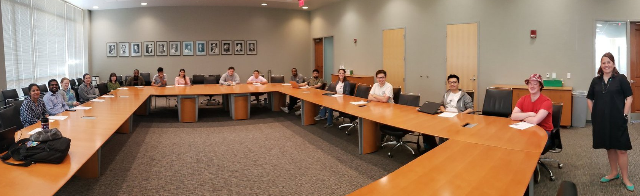
NSF-REU: Sunshine Institute for the Interaction of Light with Matter
Department of Chemistry and Biochemistry, Florida State University
REU In-Lab Mentors Workshop
May 21, 2025 - Chemical Sciences Laboratory (CSL) Room 1005
with Drs. Bridget DePrince and Ed Hilinski
left to right: Sulthana Fehroza P P; Sumesh Babu Krishnan; Lucy Jenkins;
Rachel Weiss; Fabiola Rivera; Favour Makurvet;
Shubham Bisht; Divya Kumar; Ethan Lambert; Holly Konrad;
Femi Araoyinbo; Mohammad Khizr; Sarah Bennett;
Justin Oh; Stephen Yuwono; Thomas Brumback; Bridget DePrince
8

Slide 9
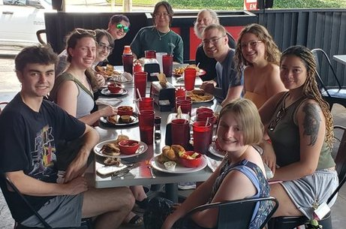
NSF-REU: Sunshine Institute for the Interaction of Light with Matter
Department of Chemistry and Biochemistry, Florida State University
MaryLove Han
Lauren Noggle
Ed Hilinski
Ashleigh Roberts
Nick Paris
Izzy Thompson
Aliyyah
Roberson
Mara Connelly
Max Kovall
Katie Crouch
9

Slide 10
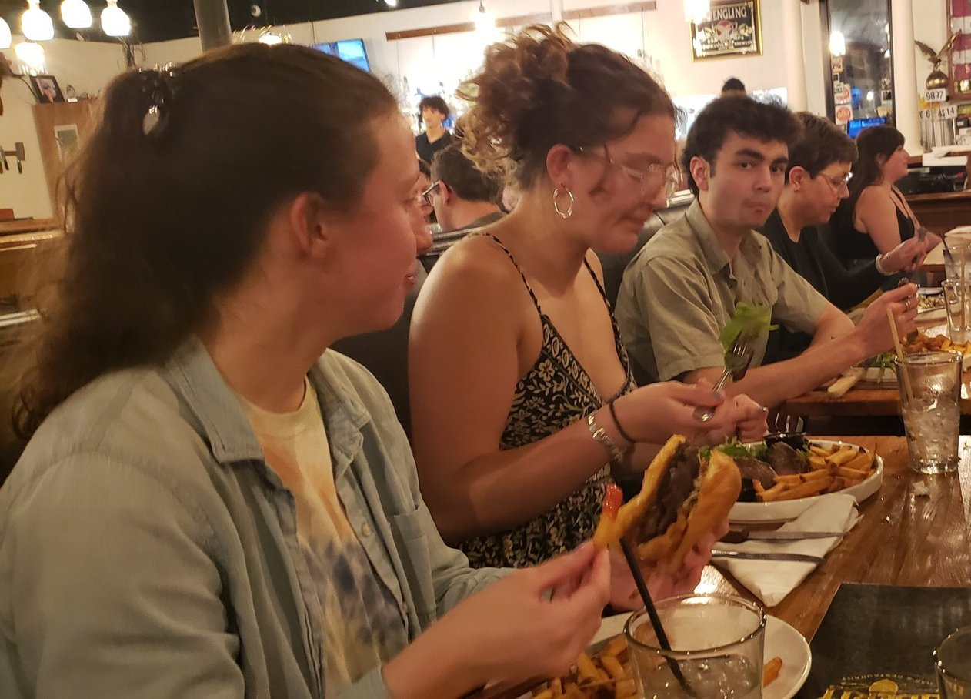
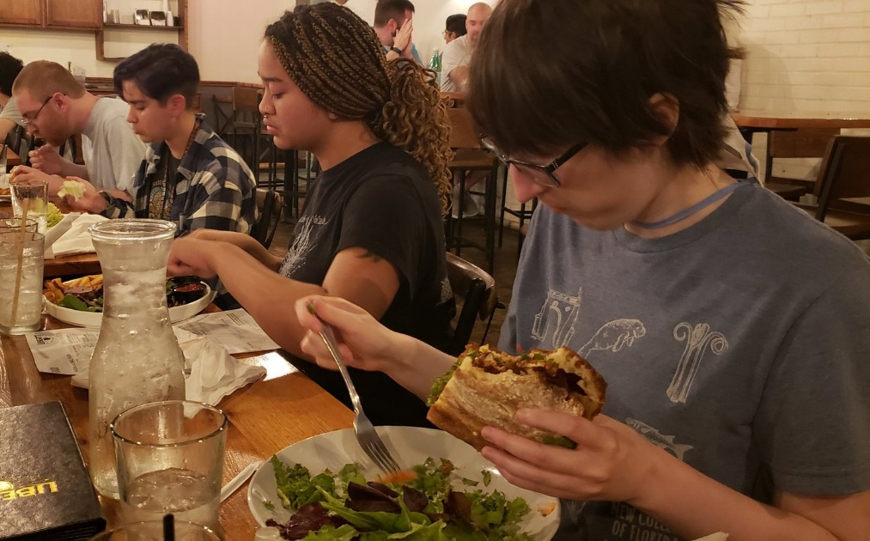
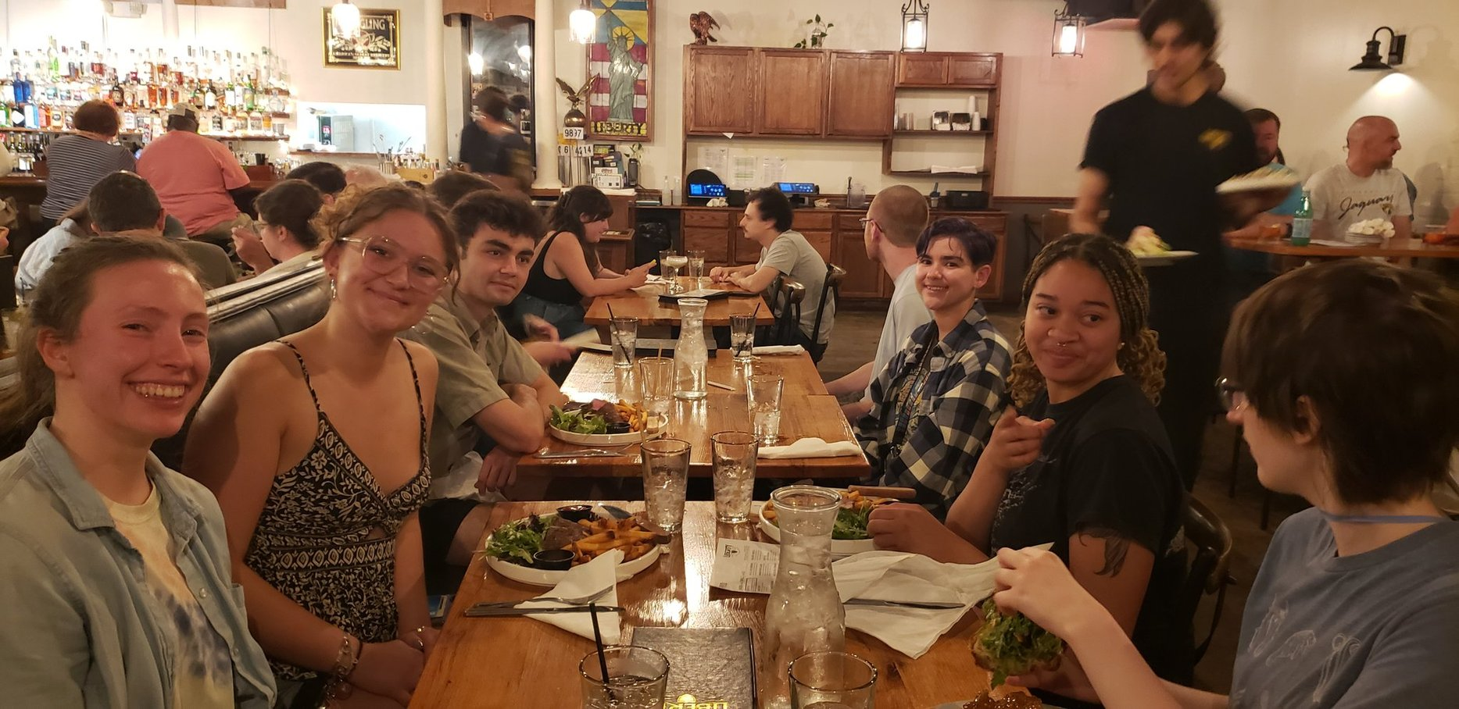
NSF-REU: Sunshine Institute for the Interaction of Light with Matter
Department of Chemistry and Biochemistry, Florida State University
First Day in Tallahassee…
Dinner !
May 26, 2024 – Liberty Bar & Restaurant
Tallahassee, Florida with Dr. Ed Hilinski
10

Slide 11
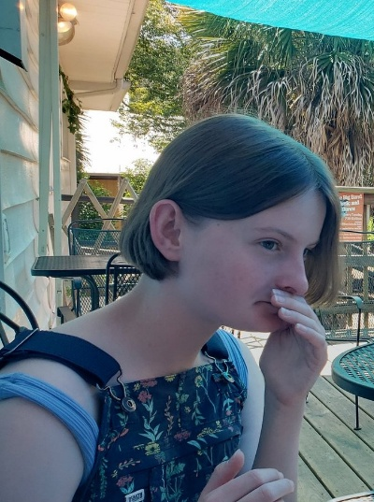
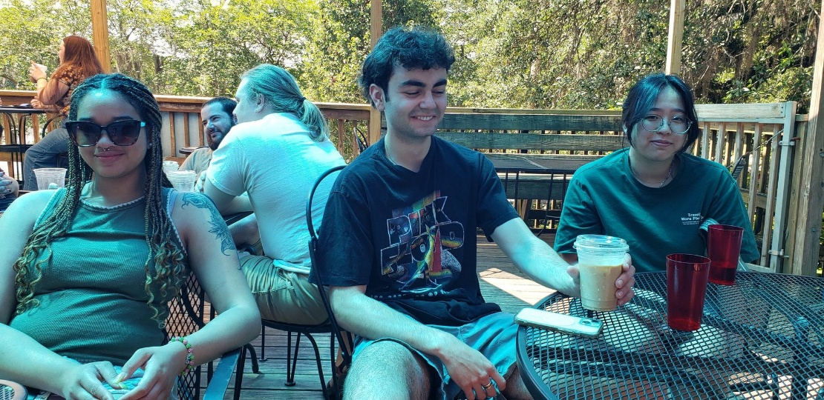
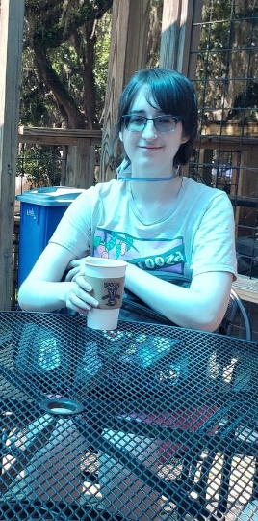
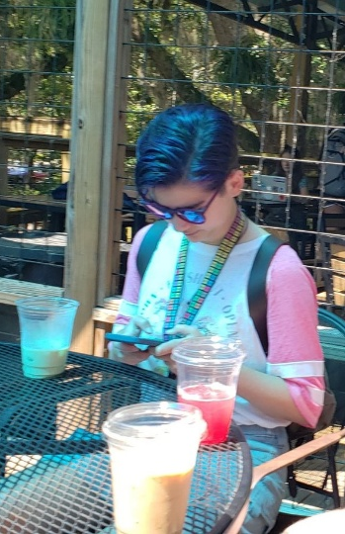
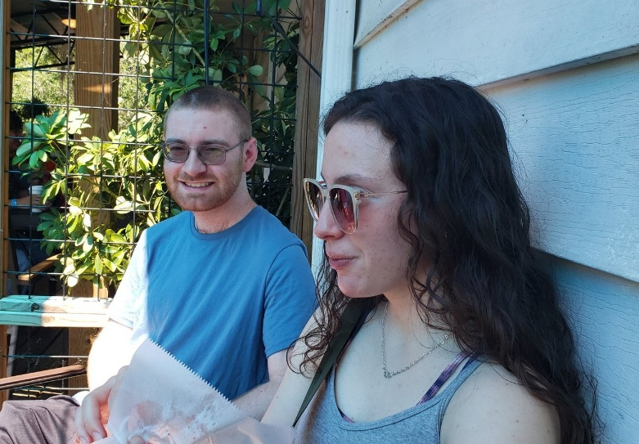
NSF-REU: Sunshine Institute for the Interaction of Light with Matter
Department of Chemistry and Biochemistry, Florida State University
Enjoying Some Conversation and Beverages
May 26, 2025 - Black Dog Café, Tallahassee, Florida with Drs. Bridget DePrince and Ed Hilinski
11

Slide 12
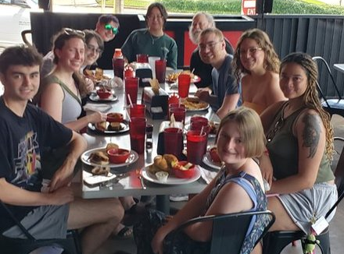
NSF-REU: Sunshine Institute for the Interaction of Light with Matter
Department of Chemistry and Biochemistry, Florida State University
Lunch before Shopping for Residence Hall Supplies
May 26, 2025 – Midtown Caboose Restaurant, Tallahassee, Florida with Dr. Ed Hilinski
12

Slide 13
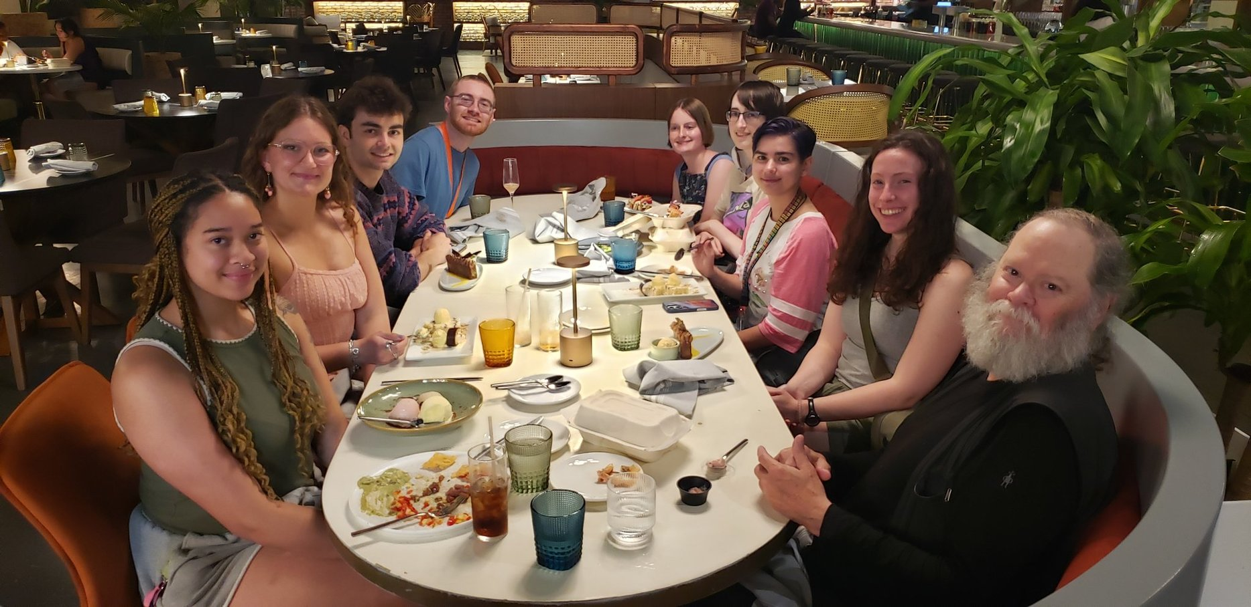
NSF-REU: Sunshine Institute for the Interaction of Light with Matter
Department of Chemistry and Biochemistry, Florida State University
Dinner Out Before the Meal Plan Starts
May 26, 2025 – The Monroe Restaurant, Tallahassee, Florida with Dr. Ed Hilinski
13

Slide 14
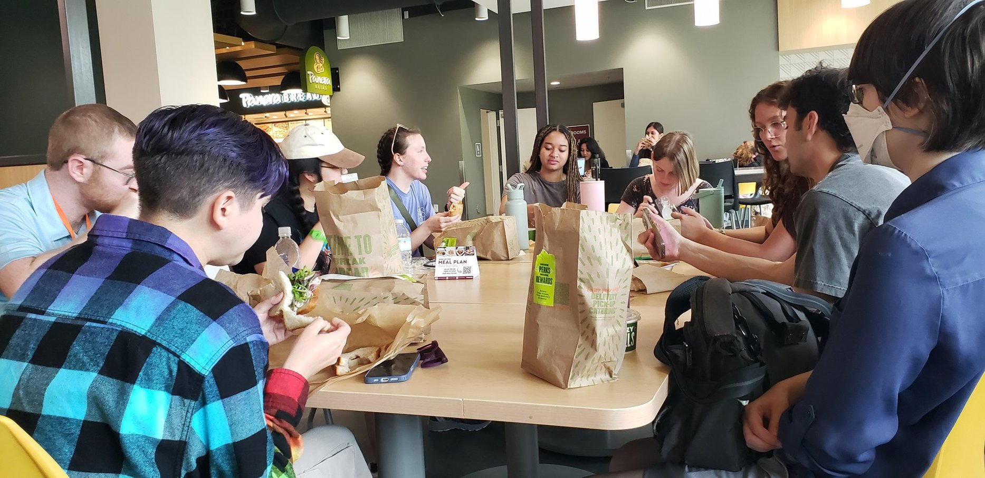
NSF-REU: Sunshine Institute for the Interaction of Light with Matter
Department of Chemistry and Biochemistry, Florida State University
After a Morning Orientation Session,
Lunch with Dining Dollars at the Student Union
May 27, 2025 – FSU Student Union, Tallahassee, Florida with Dr. Ed Hilinski
14

Slide 15
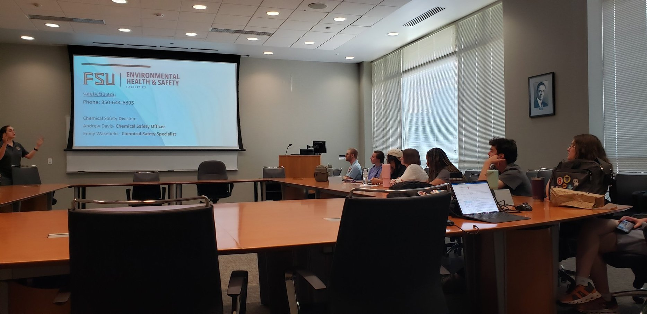
NSF-REU: Sunshine Institute for the Interaction of Light with Matter
Department of Chemistry and Biochemistry, Florida State University
Back at It… Safety Training
May 27, 2025 – Chemical Sciences Laboratory (CSL) Room 1005
with Andrew Davis and Emily Wakefield
15

Slide 16
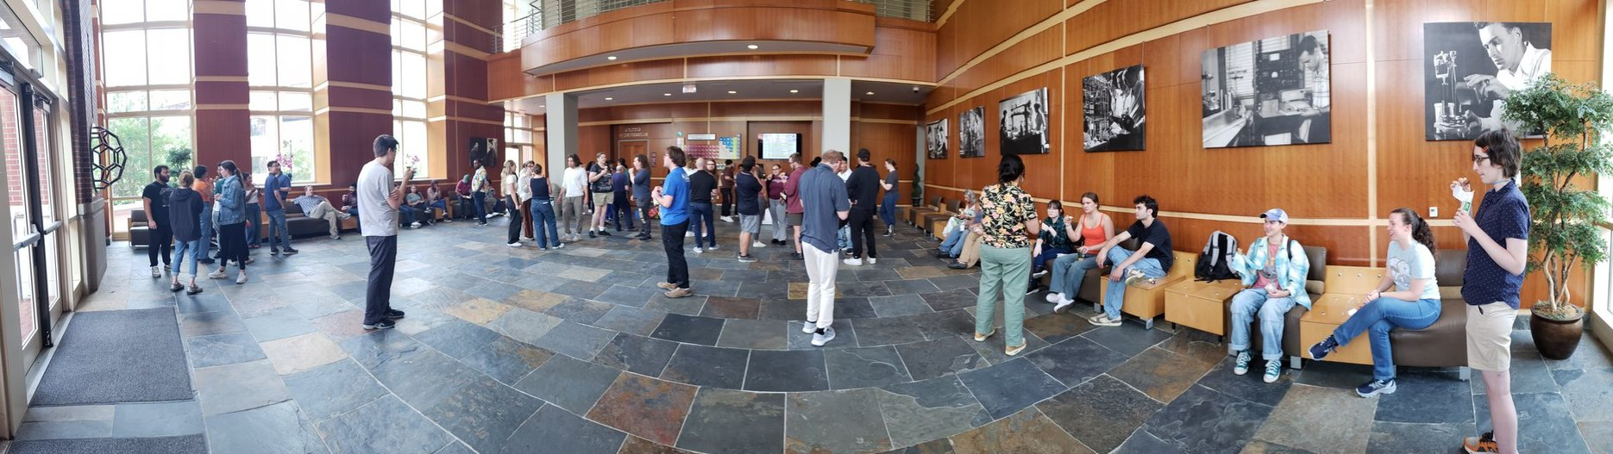
NSF-REU: Sunshine Institute for the Interaction of Light with Matter
Department of Chemistry and Biochemistry, Florida State University
Ice Cream Social
May 28, 2025 – 3:30 to 4:30 p.m. in the CSL Lobby
Everyone in the FSU Chemistry & Biochemistry Community is invited.
16

Slide 17
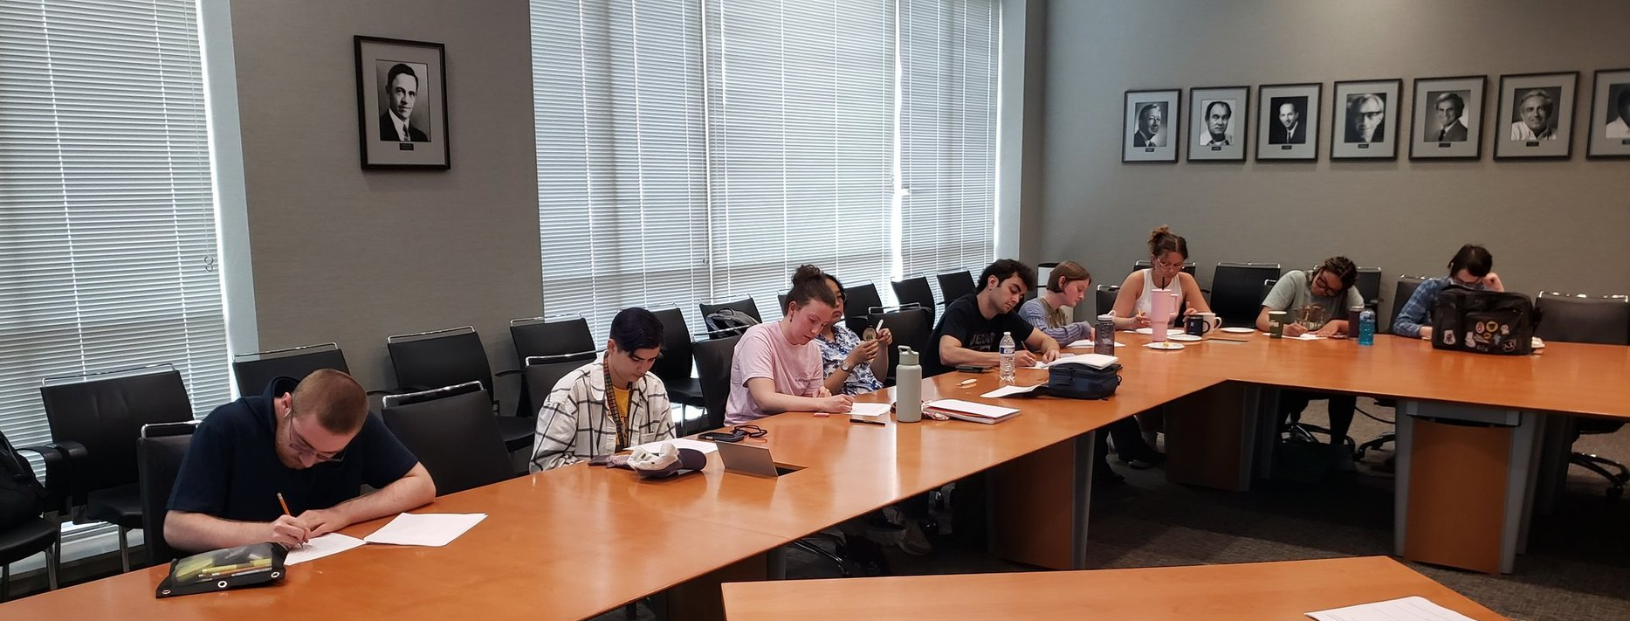
NSF-REU: Sunshine Institute for the Interaction of Light with Matter
Department of Chemistry and Biochemistry, Florida State University
REU Weekly Seminar
May 30, 2025 – CSL 1005, 3:30-5:00 p.m. with Dr. Ed Hilinski
Entry survey, entry quiz, summary of the first week, research ethics, lab culture, lab notebooks, expectations,
Research resources, tutorials, learning beyond lab, SciFinder Scholar, NMR training, ChemDraw, other software
https://guides.lib.fsu.edu/c.php?g=352310&p=2380486
http://www.chem.fsu.edu/reu-links/
17

Slide 18
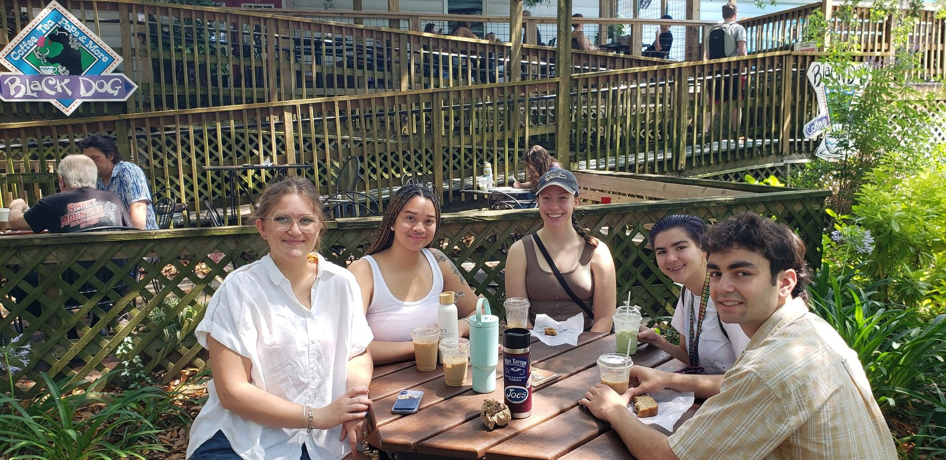
NSF-REU: Sunshine Institute for the Interaction of Light with Matter
Department of Chemistry and Biochemistry, Florida State University
The Weekend:
Beverages and Catching Up
May 31, 2025 – Black Dog Café, Tallahassee, Florida with Dr. Ed Hilinski
18

Slide 19
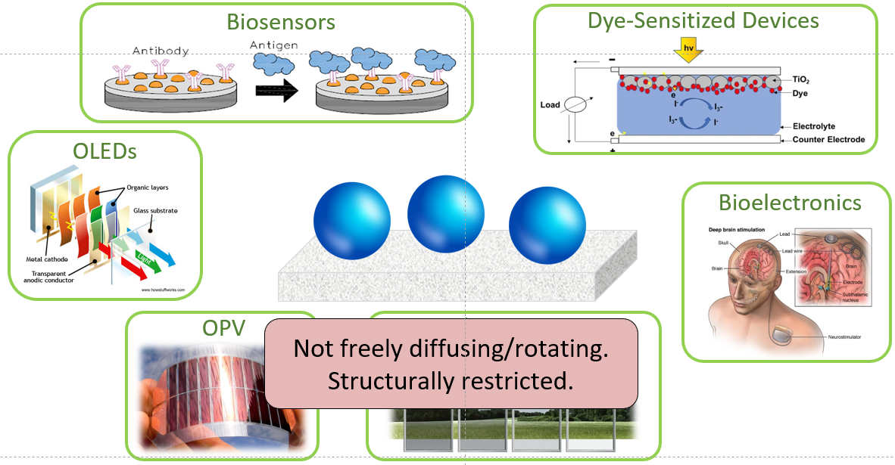
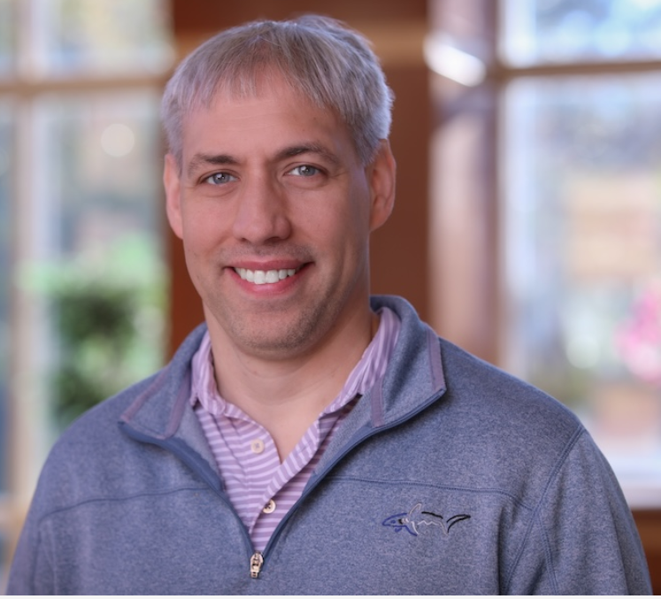
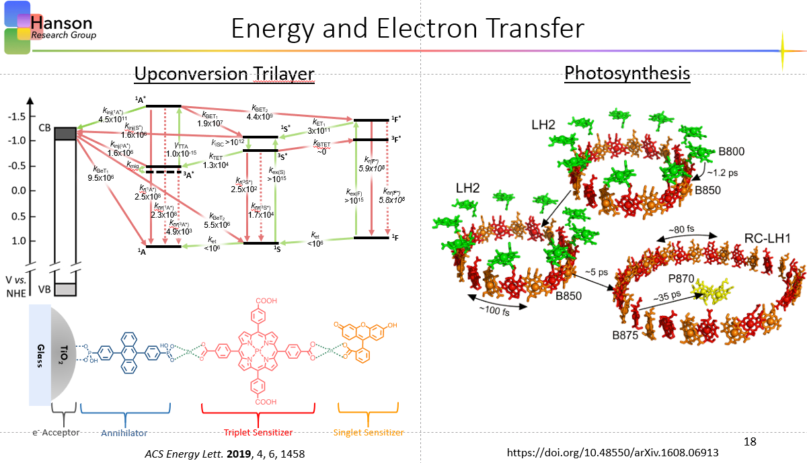
NSF-REU: Sunshine Institute for the Interaction of Light with Matter
Department of Chemistry and Biochemistry, Florida State University
Photochemistry Café
“Understanding and Controlling Excited States at
Molecule-Metal Oxide Interfaces”
http://www.chem.fsu.edu/reu-links/
Prof. Kenneth Hanson
June 3, 2025, 9:00-10:00 p.m.
CSL 1005, Tallahassee, Florida
19

Slide 20
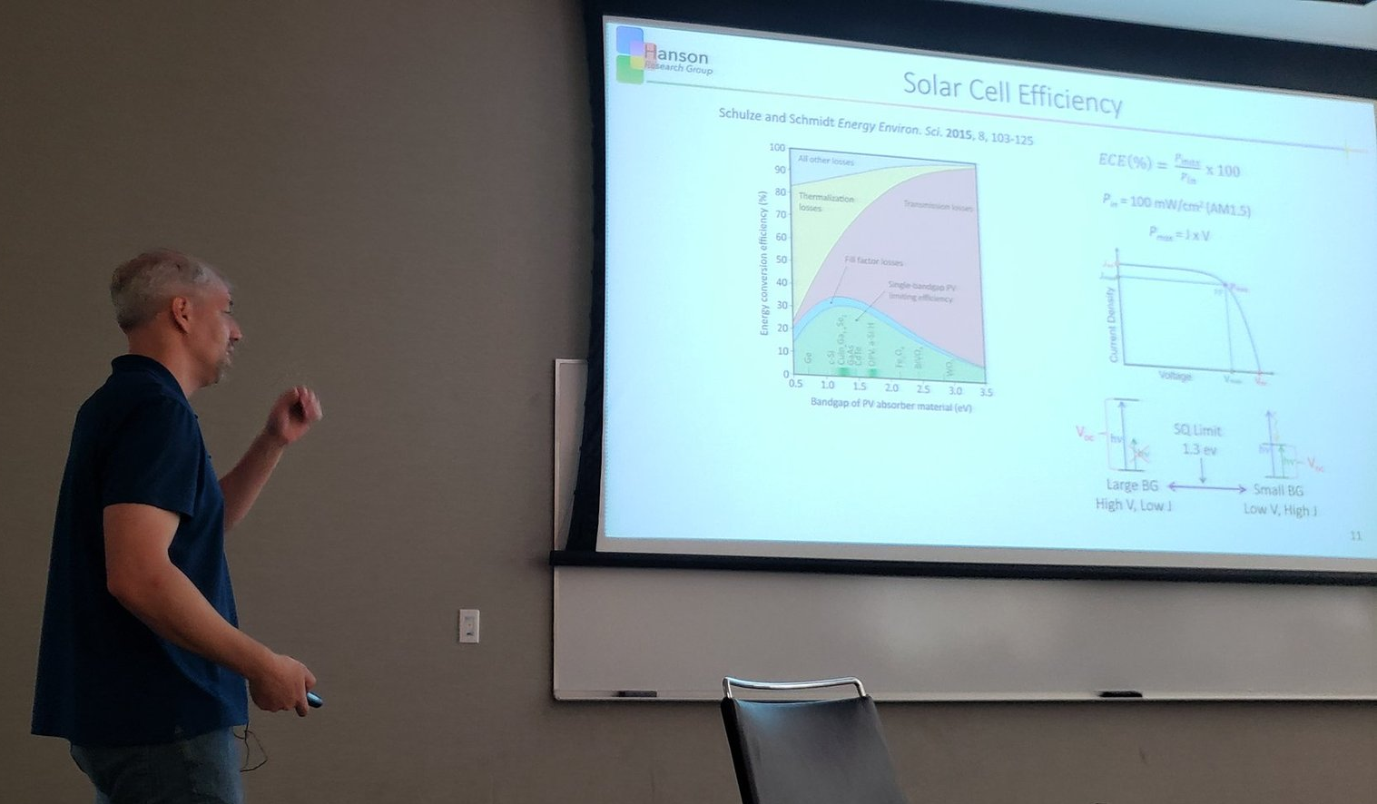
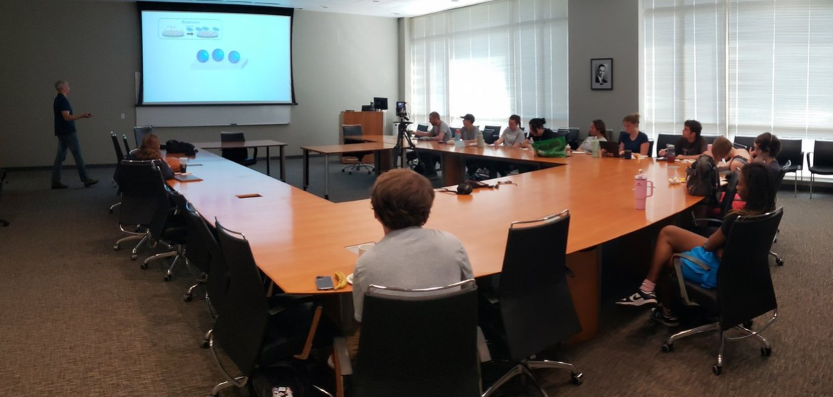
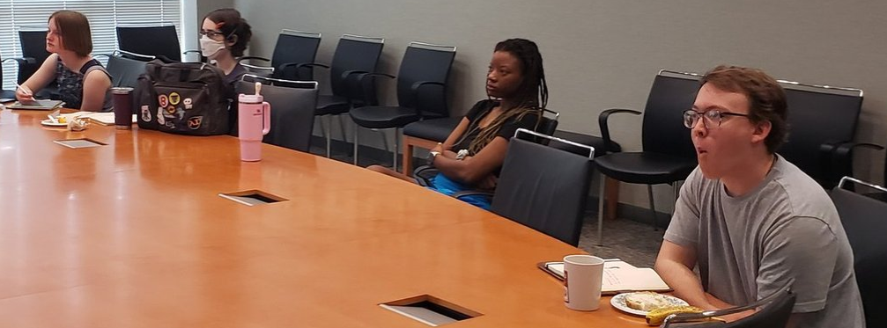
NSF-REU: Sunshine Institute for the Interaction of Light with Matter
Department of Chemistry and Biochemistry, Florida State University
Photochemistry Café
“Understanding and Controlling Excited States at
Molecule-Metal Oxide Interfaces”
http://www.chem.fsu.edu/reu-links/
Prof. Kenneth Hanson
June 3, 2025, 9:00-10:00 p.m.
CSL 1005, Tallahassee, Florida
20

Slide 21
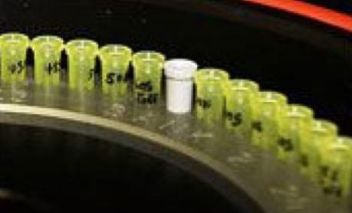
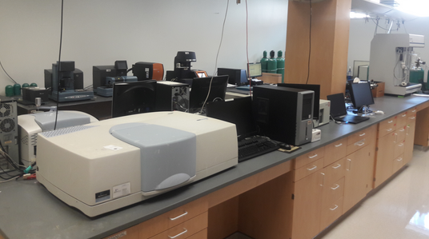
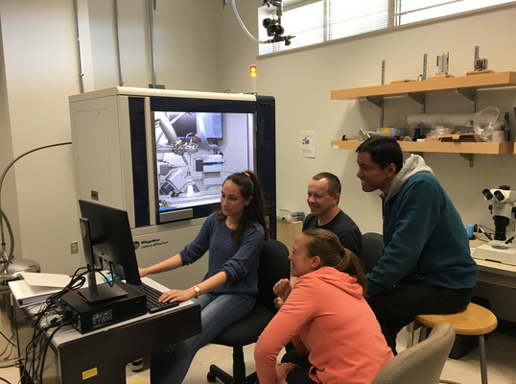
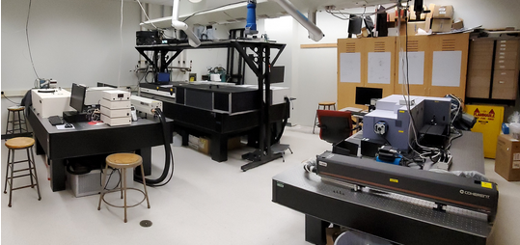
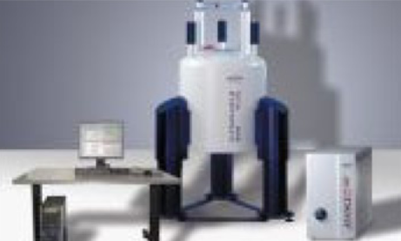
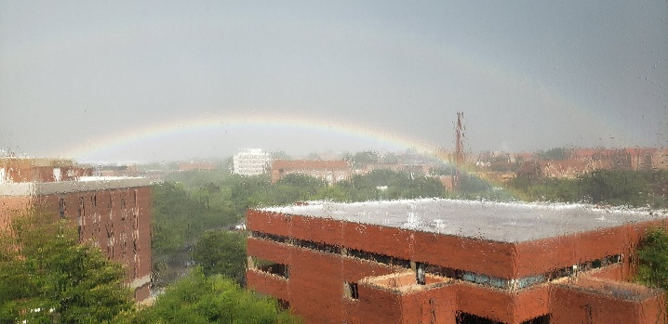
NSF-REU: Sunshine Institute for the Interaction of Light with Matter
Department of Chemistry and Biochemistry, Florida State University
Tour of Departmental Shared Research Facilities
June 3, 2025 – CSL with Prof. Ken Hanson
Mass Spectrometry Laboratory (MASS Lab)
Materials Characterization Laboratory (MAC Lab)
X-Ray Lab
Spectroscopy Lab
NMR Lab
June 5 – after a thunderstorm,
some nice optical phenomena
21

Slide 22

NSF-REU: Sunshine Institute for the Interaction of Light with Matter
Department of Chemistry and Biochemistry, Florida State University
After a Thunderstorm, the View Outside a CSL 5th Floor East Side Window…
Nice Optical Splendors
June 5, 2025 – CSL with Dr. Ed Hilinski
22

Slide 23
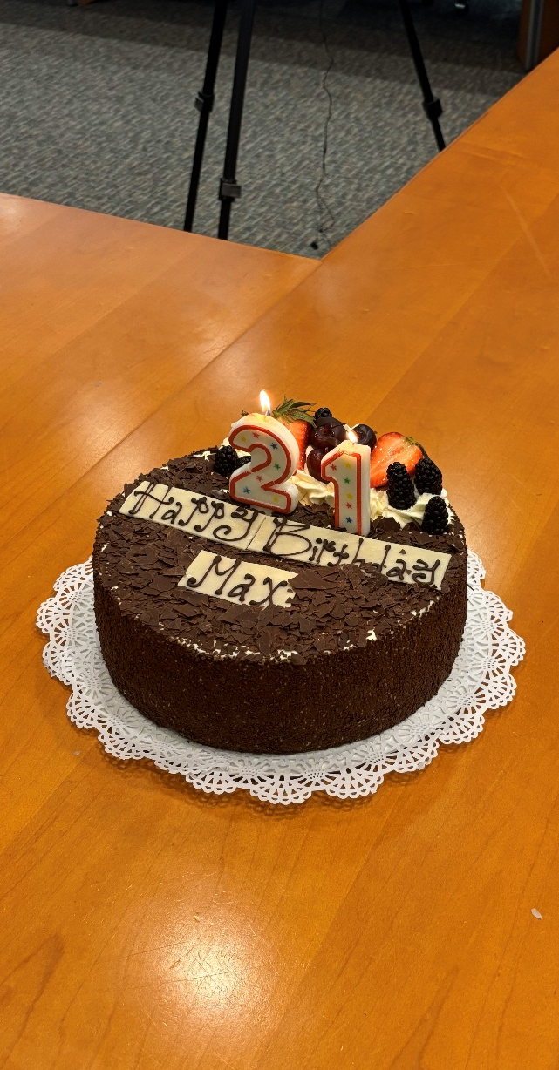
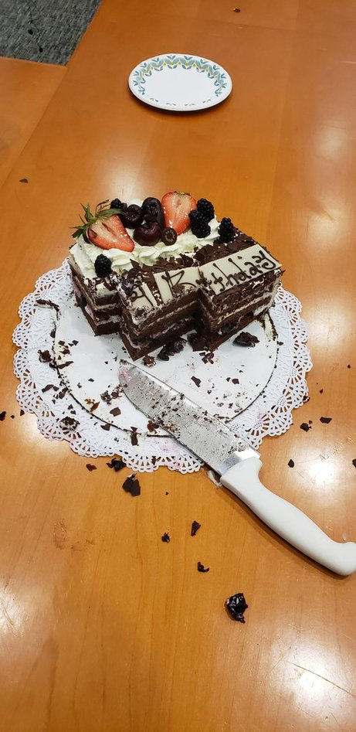
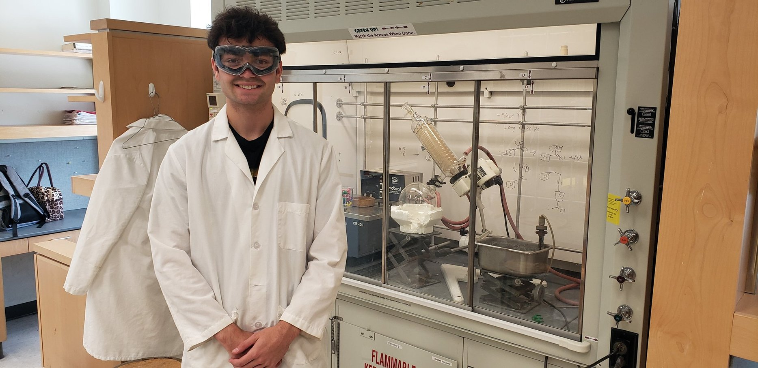
NSF-REU: Sunshine Institute for the Interaction of Light with Matter
Department of Chemistry and Biochemistry, Florida State University
Happy Birthday, Max!
June 6, 2025 – CSL 1005, Tallahassee, Florida
Black Forest Cake from
Au Péché Mignon French Pastry Shop
https://www.frenchpastrytallahassee.com/
23

Slide 24
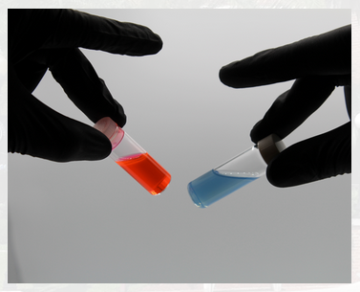
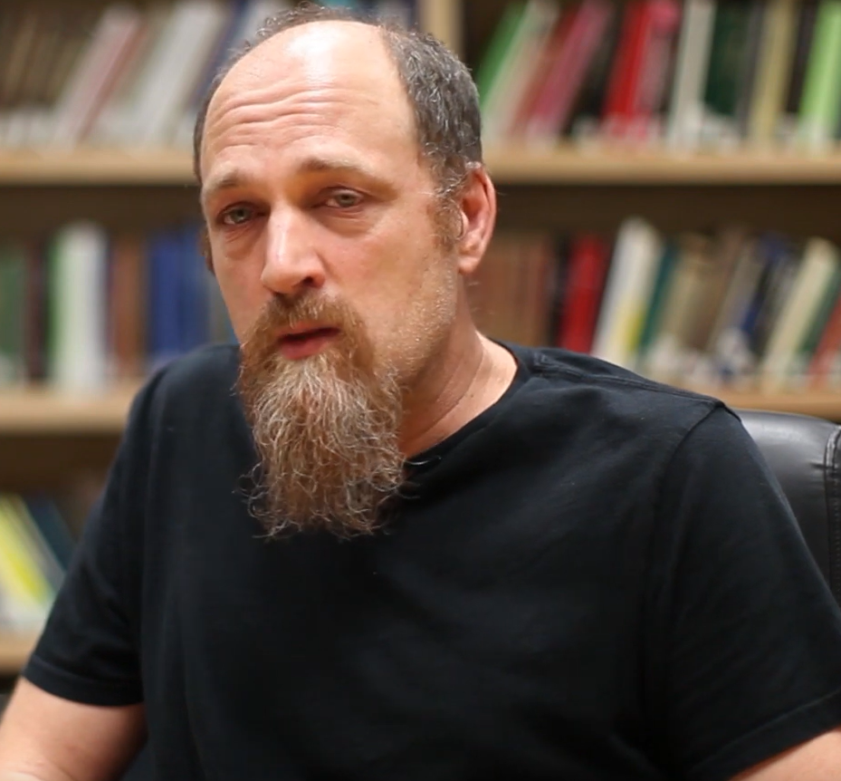
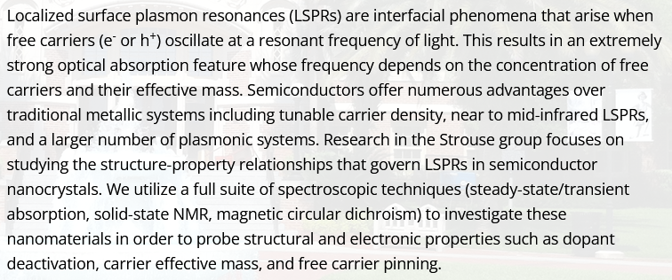
NSF-REU: Sunshine Institute for the Interaction of Light with Matter
Department of Chemistry and Biochemistry, Florida State University
Photochemistry Café
“Plasmonic Semiconductor Nanocrystals”
http://www.chem.fsu.edu/reu-links/
Prof. Geoffrey Strouse
June 6, 2025, 3:30-4:30 p.m.
CSL 1005, Tallahassee, Florida
24

Slide 25
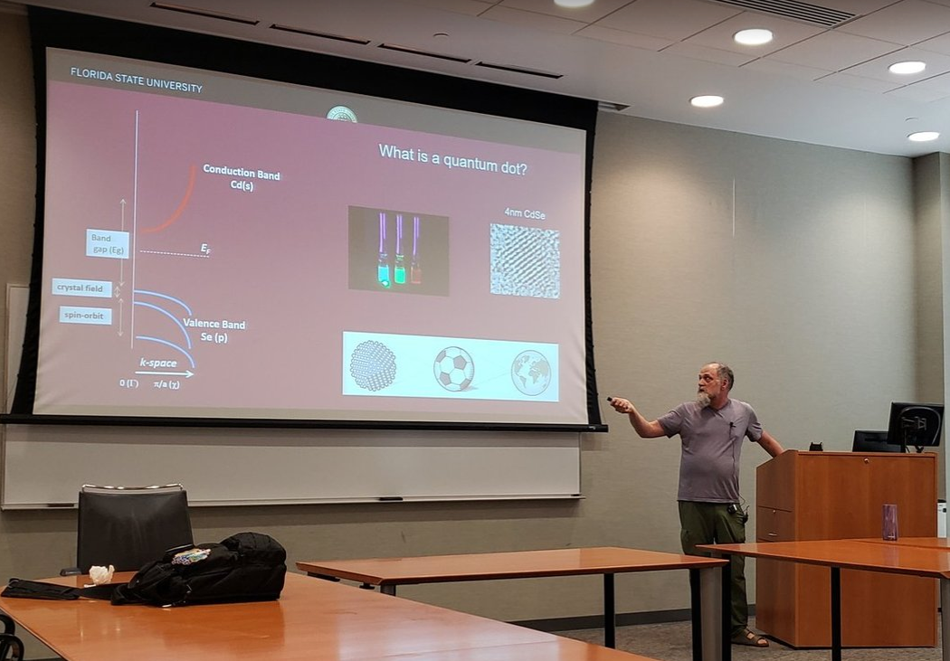
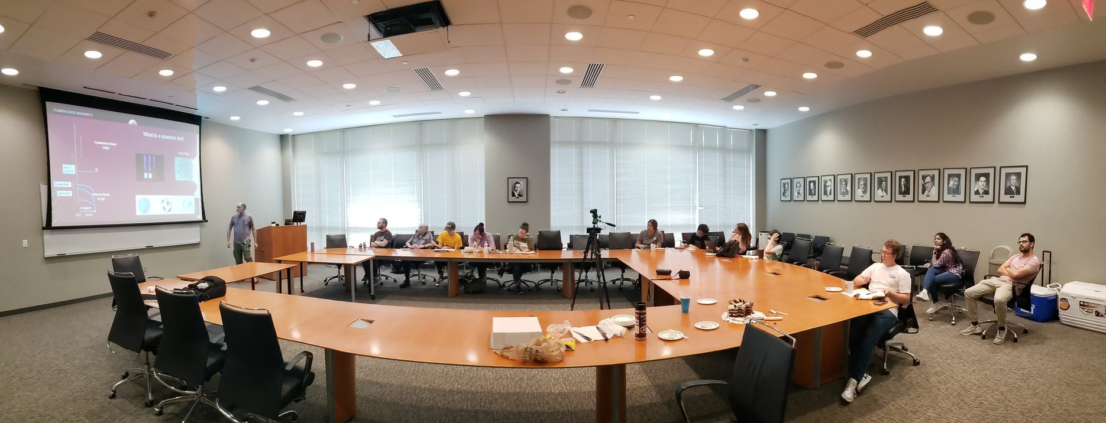
NSF-REU: Sunshine Institute for the Interaction of Light with Matter
Department of Chemistry and Biochemistry, Florida State University
Photochemistry Café
“Plasmonic Semiconductor Nanocrystals”
http://www.chem.fsu.edu/reu-links/
Prof. Geoffrey Strouse
June 6, 2025, 3:30-4:30 p.m.
CSL 1005, Tallahassee, Florida
25

Slide 26
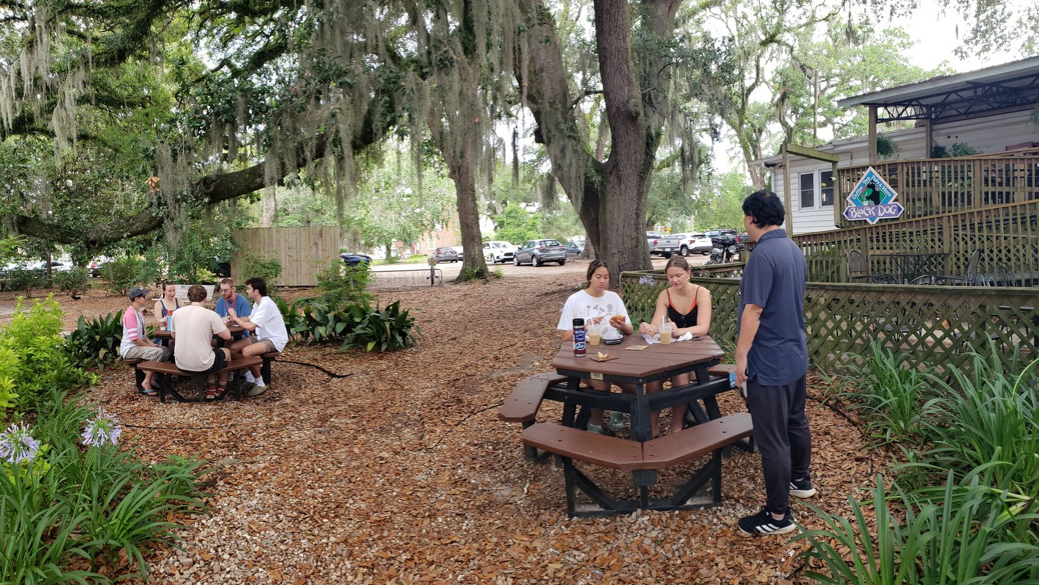
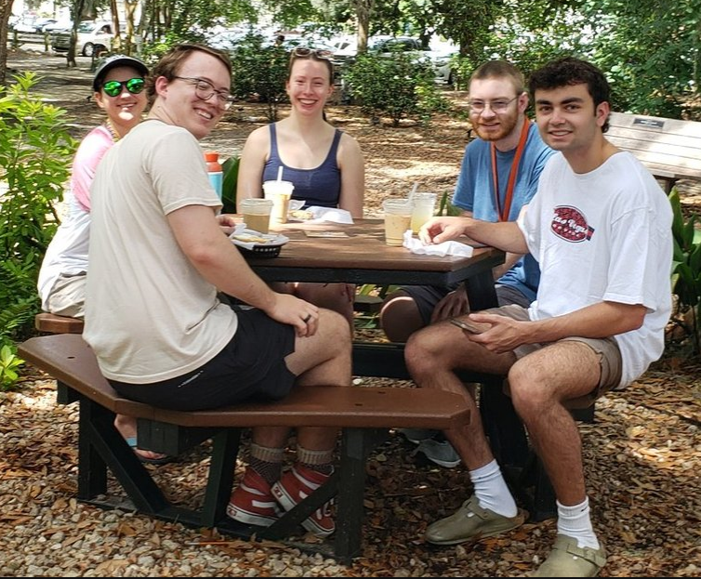
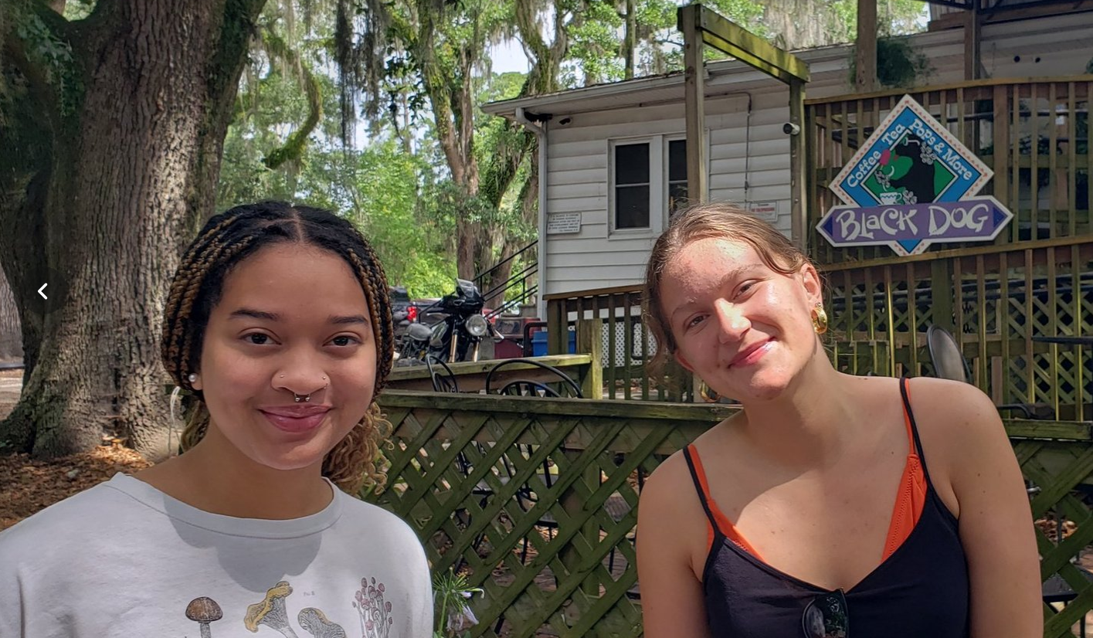
NSF-REU: Sunshine Institute for the Interaction of Light with Matter
Department of Chemistry and Biochemistry, Florida State University
Under the Oaks at Lake Ella
June 7, 2025 – Black Dog Café, Tallahassee, Florida with Profs. Wei Yang and Ed Hilinski
26

Slide 27
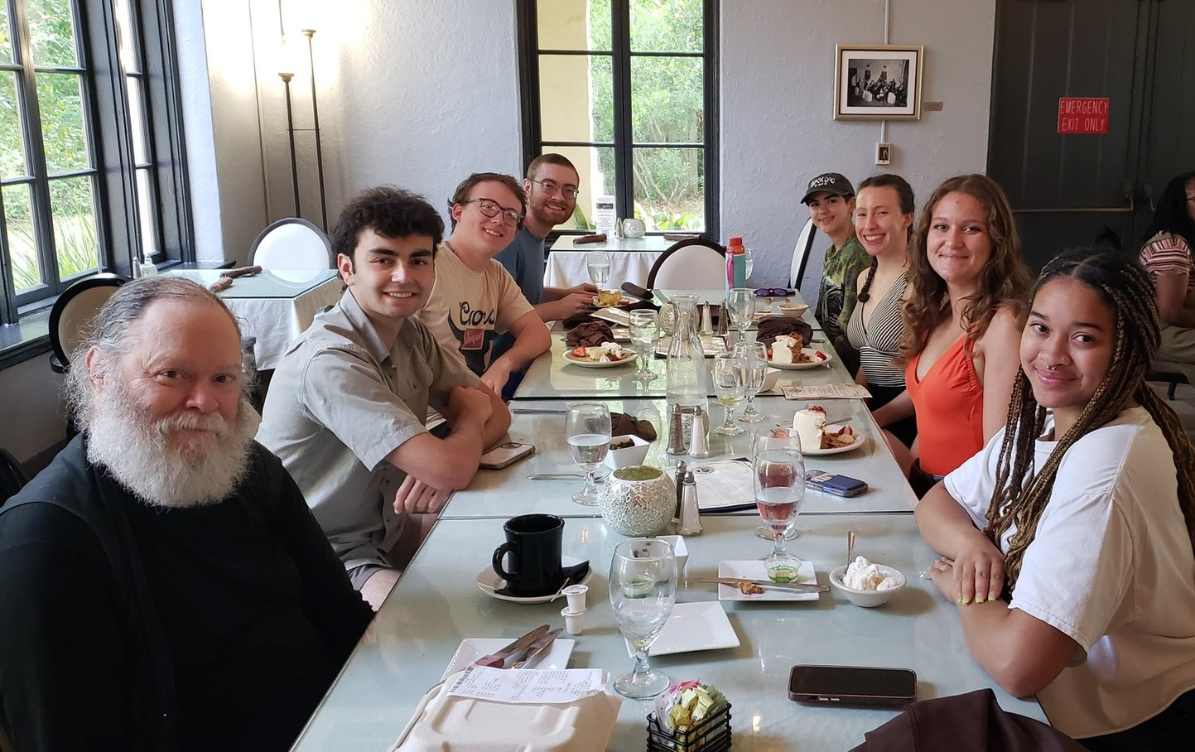
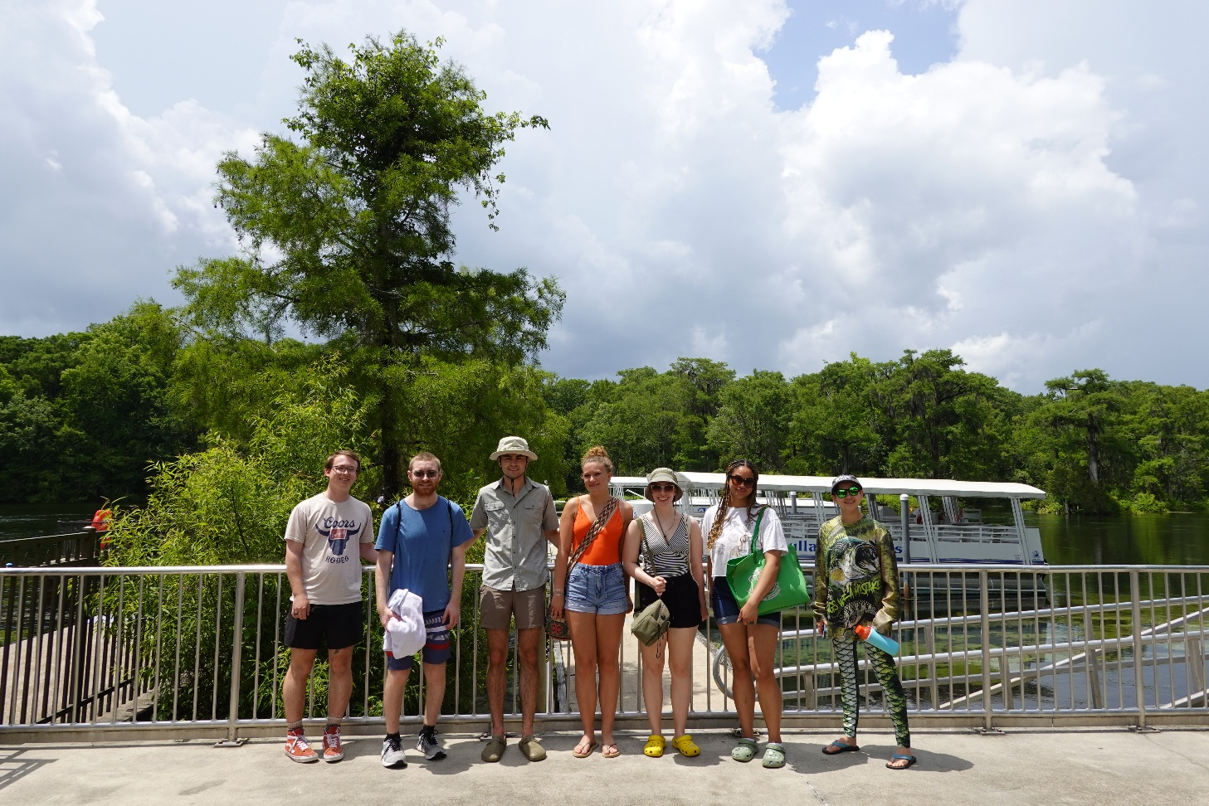
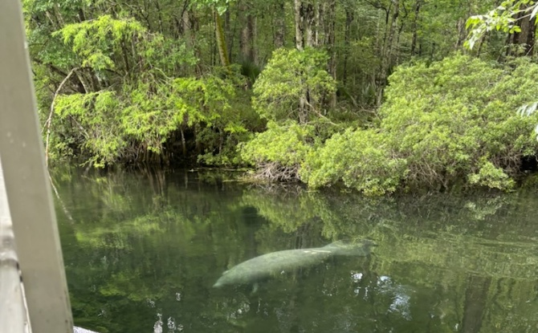
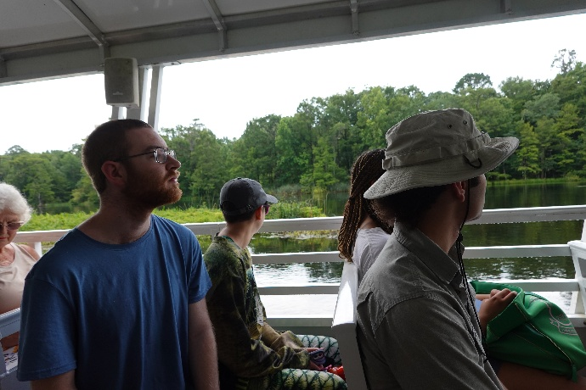
NSF-REU: Sunshine Institute for the Interaction of Light with Matter
Department of Chemistry and Biochemistry, Florida State University
Wakulla Springs Excursion
https://thelodgeatwakullasprings.com/
June 7, 2025, Wakulla, Florida
with Ed Hilinski
27

Slide 28
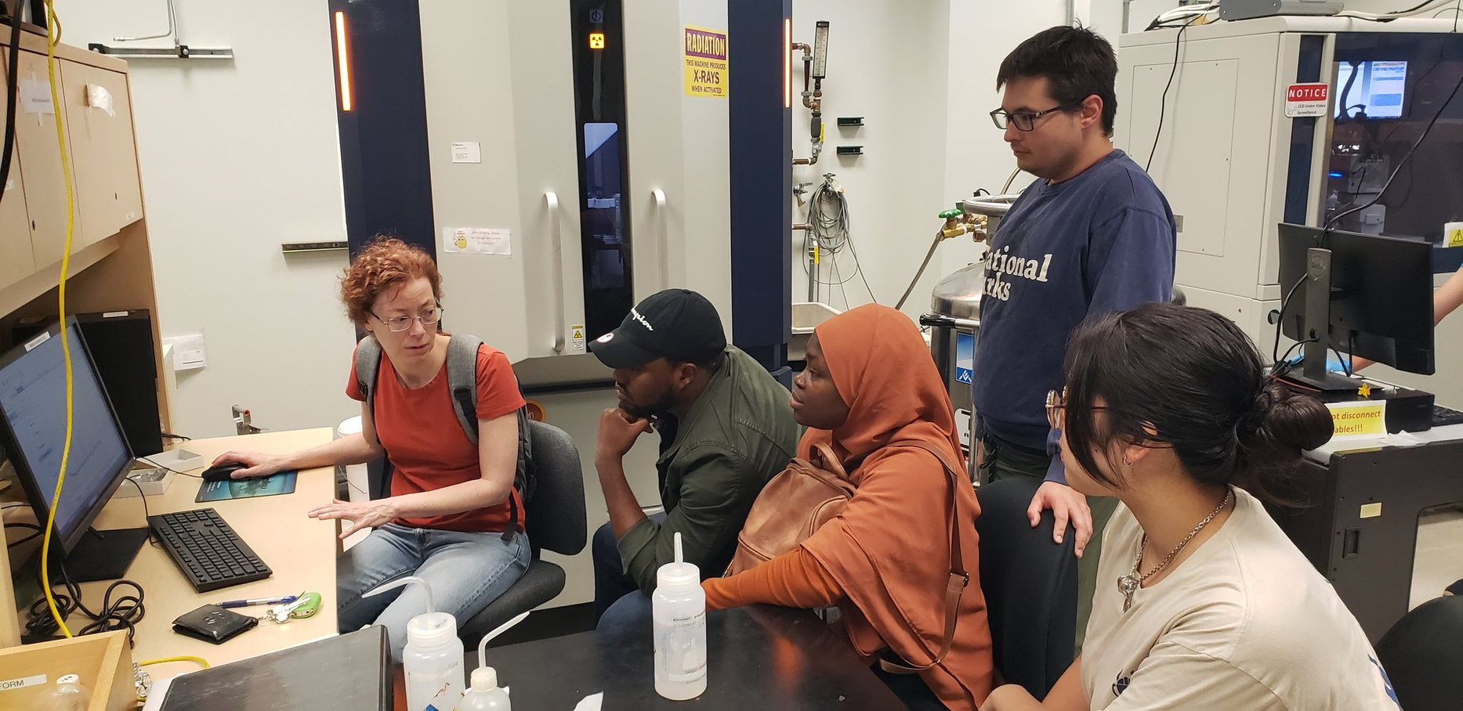
NSF-REU: Sunshine Institute for the Interaction of Light with Matter
Department of Chemistry and Biochemistry, Florida State University
In the X-Ray Lab, Going Over the Analysis of a new Crystal Phase
June 9, 2025, Chemical Sciences Laboratory (CSL), Tallahassee, Florida
Rofiat Sowemimo
(1st-yr Graduate Student)
Femi Araoyinbo
(In-Lab Mentor)
Justin Oh
(In-Lab Mentor)
Prof. Susan Latturner
MaryLove Han
(REU Student
Participant)
28

Slide 29
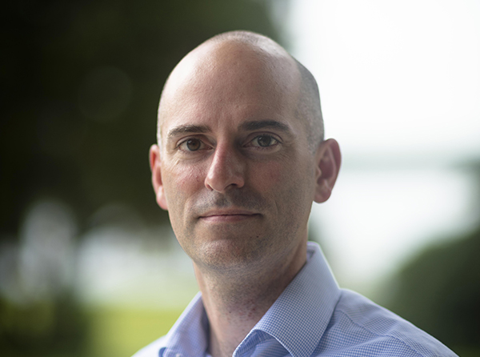


NSF-REU: Sunshine Institute for the Interaction of Light with Matter
Department of Chemistry and Biochemistry, Florida State University
Cavity-molecule Interactions
Strong coupling of photonic and molecular degrees of freedom can lead to the formation of hybrid light-matter states known as polaritons that can exhibit significantly different properties relative to the original uncoupled states. For example, as the animation below shows, the optical properties of a molecule can be dramatically altered via sufficiently strong coupling to a cavity. In this case, an absorption feature in formaldehyde (described by a cavity quantum electrodynamics [QED] generalization of equation-of-motion [EOM] coupled-cluster [CC] theory and a minimal basis) splits into a lower and upper polariton state, separated by what is called the Rabi splitting, which, in this case, can exceed 1 eV.
Photochemistry Café
“Modeling Chemistry
in an Optical Cavity”
http://www.chem.fsu.edu/reu-links/
Prof. A. Eugene DePrince
June 10, 2025, 9:00-10:00 a.m.
CSL 1005, Tallahassee, Florida
29

Slide 30




NSF-REU: Sunshine Institute for the Interaction of Light with Matter
Department of Chemistry and Biochemistry, Florida State University
Photochemistry Café
“Modeling Chemistry
in an Optical Cavity”
http://www.chem.fsu.edu/reu-links/
Prof. A. Eugene DePrince
June 10, 2025, 9:00-10:00 a.m.
CSL 1005, Tallahassee, Florida
30

Slide 31





NSF-REU: Sunshine Institute for the Interaction of Light with Matter
Department of Chemistry and Biochemistry, Florida State University
Tour of the National High Magnetic Field Laboratory
nationalmaglab.org/
June 11, 2025, 10:00-11:00 a.m. - Innovation Park, Tallahassee, Florida
Depart from CSL Lobby at 9:30 a.m. with Edan Schultz and Ed Hilinski
31

Slide 32

NSF-REU: Sunshine Institute for the Interaction of Light with Matter
Department of Chemistry and Biochemistry, Florida State University
Tour of the National High Magnetic Field Laboratory
nationalmaglab.org/
June 11, 2025, 10:00-11:00 a.m. - Innovation Park, Tallahassee, Florida
Depart from CSL Lobby at 9:30 a.m. with Dr. Ed Hilinski
left to right: Katie Crouch, Ashleigh Roberts, Lauren Noggle, Nick Paris, Ethan Dailey,
Mara Connolly, Marylove Han, Aliyyah Roberson, Izzy Thompson
32

